Slide 1

Jim Antonisse/Simon Jackson/Rob Smith/Steve Smyth/Gabor Soros/Christine Perey 27 June 2025
GeoPose
Workshop Time, Uncertainty, and Visual Positioning Support
in
OGC GeoPose 1.x

Slide 2
The Metaverse Standards Forum
and
The Open Geospatial Consortium

Slide 3
About the Metaverse Standards Forum
The Metaverse Standards Forum is a non-profit, member-funded consortium of standards-related organizations, companies, and institutions that are cooperating to foster interoperability for an open and inclusive metaverse.
Originally founded in June 2022, the Forum was incorporated as a new non-profit entity in April 2023 to accelerate its mission to enable and promote broad cooperation and coordination over metaverse-related standards activities.
The Forum does not itself create standards. Through its Domain Groups, it generates domain and technical reports, use case and requirements recommendations, pilots, testbeds and plugfests, open source tooling, best practices and guidelines, and other data, insights, and visibility to enable standards organizations to accelerate the development and evolution of standards that will be essential to building the metaverse.
Members participate in Forum WG and plenary meetings. Principal members make decisions.
Forum participation creates no patent licensing obligations.
Forum activities are non-confidential.
All Forum deliverables are freely and publicly distributed.

Slide 4
About the OGC GeoPose Working Group
The GeoPose SWG maintains v1.0 of the OGC standard and is responding to requests for enhancements in 2025-2026.
GeoPose enables the communication of the location and orientation of objects.
A GeoPose can be used to describe where a sensor is and where it is pointed.
GeoPoses are built from components. GeoPose components can be combined to meet the requirements of specific use cases. They may also be used on their own in application-dependent combinations.
The SWG is enhancing v1.0 by
making the component structure explicit,
addressing some issues with the representation of time and uncertainty, and
providing specific support for visual positioning – the process of computing the pose of an image using a reference model of a bounded region of space and time.
There are 8 work packages identified. Contributors are welcome. Results of some of these WP will appear in future releases of the OGC GeoPose standard.

Slide 5
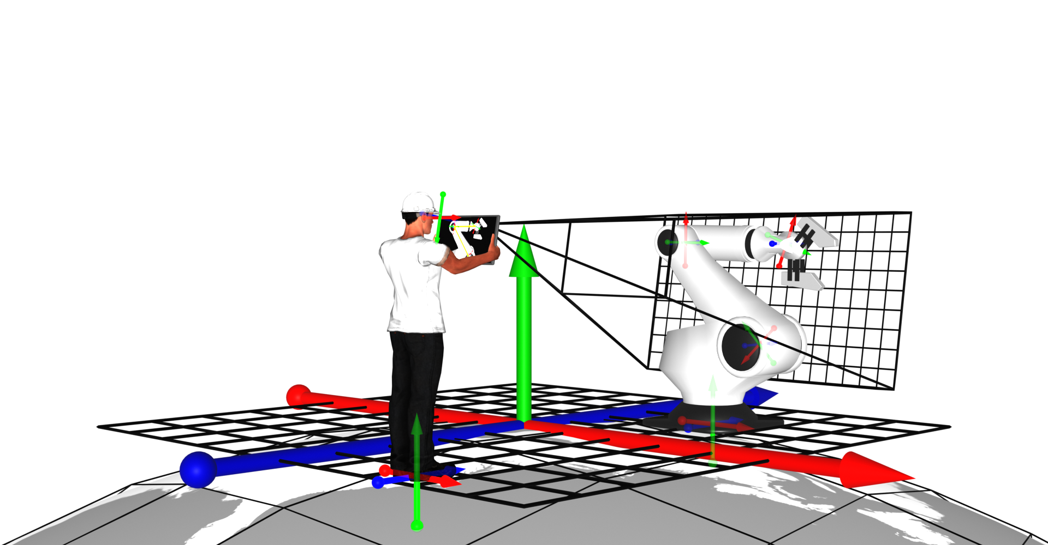
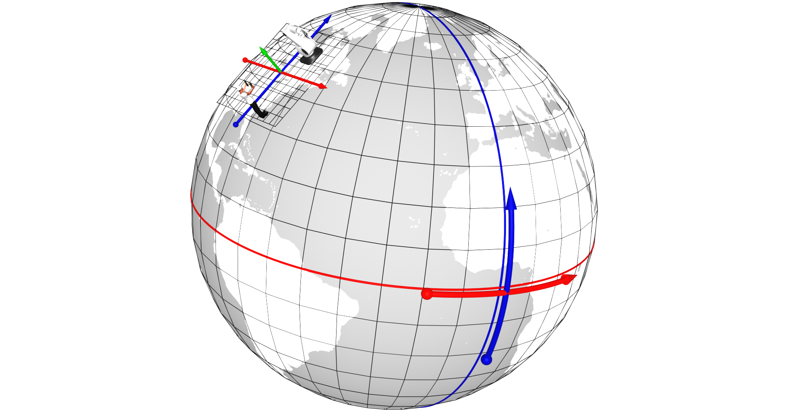
What is a GeoPose?
To relate the objects and their poses in the site Cartesian frame to other objects in the real world, e.g. from geospatial databases, or to link with other systems, we extend the frame graph outwards to link our Cartesian frame to a geospatial topocentric reference frame.

Slide 6
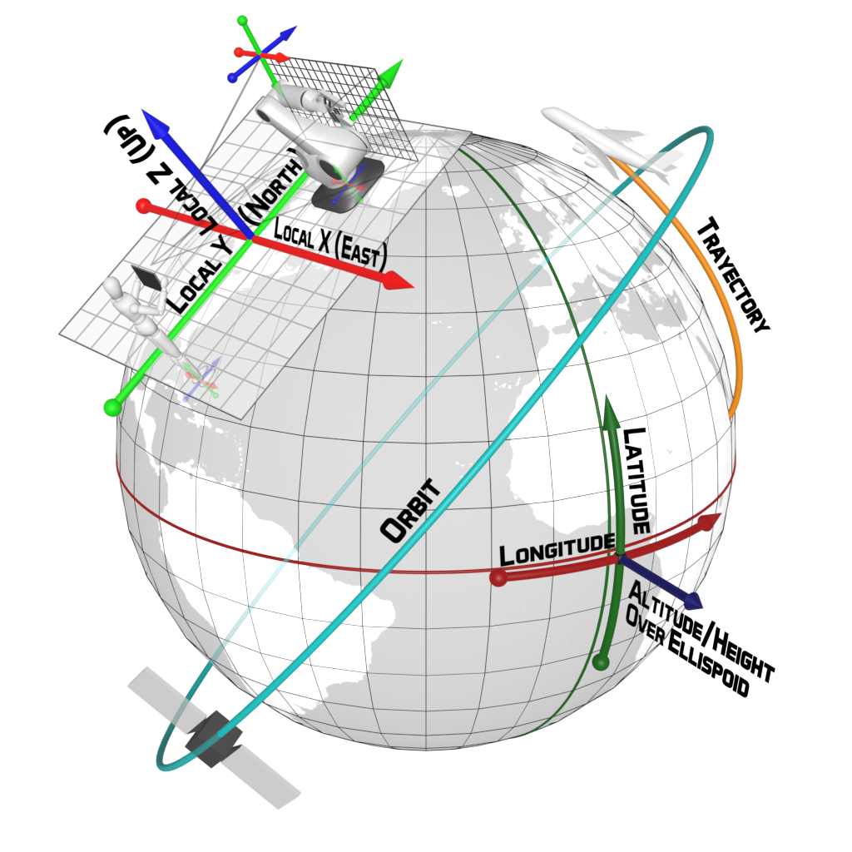
Standard defines a data model
A standardised data model and encoding to express, capture, save and share the 6DOF position and orientation of any real or digital object and observer in the real world.
Everything has a GeoPose
More at http://geopose.org

Slide 7
Agenda
Introduction – Steve Smyth [5 minutes]
GeoPose is a Core Element
Visual Positioning Overview – Simon Jackson/Ethar [30 minutes]
What is Visual Positioning?
Technology Landscape
Market
Questions and discussion.
Metaverse Standards Forum Ride-Hailing Prototype – Steve Smyth [5 minutes]
Visual Positioning prototypes – 30 minutes
Point cloud matching – Gabor Soros/Nokia Bell Labs [15 minutes]
Radiance Field matching – Steve Smyth [10 minutes]
MSF Forum Labs benchmarking project – Christine Perey [10 minutes]
Visual Positioning support in OGC GeoPose 1.x - 50 minutes
Twenty-one new GeoPose components in Work Packages 5, 7, and 8 – Steve Smyth [5 minutes]
Time coordinate – Rob Smith [15 minutes]
Uncertainty – Jim Antonisse/Steve Smyth [15 minutes]
Image elements – Steve Smyth - [15 minutes]
Discussion: Take Proposed GeoPose Enhancements to Draft Status – 60 minutes
Wrap-up

Slide 8
Introduction: Time, Uncertainty, and Visual Positioning Support. 0:10

Slide 9
Visual Positioning Simon Jackson/Ethar Christine Perey/Perey Research.

Slide 10



The AREA is…
the only global, membership-funded
non-profit alliance dedicated to accelerating the adoption of Enterprise Augmented Reality (AR) by supporting the growth of a comprehensive ecosystem
Thought Leadership
Networking
& Marketing
Education
Reducing Barriers to adoption
10
Research
Requirements
Safety
Security

Slide 11












































Software & Services
Enterprise
Non- Commercial
Hardware
& Services
MEMBERS
AREA is the only global member-based organization dedicated to accelerating the adoption of Augmented Reality in the enterprise.

Slide 12


Visual Positioning Systems
for Enterprise AR Use Cases

Slide 13



RESEARCH TEAM
SIMON JACKSON
Senior AR Architect and Engineer
Microsoft MVP
Spatial Computing Specialist
Co-Creator of Mixed Reality Toolkit and successors
TONY HODGSON
CEO
3x Startup Founder
NASA 3D Modeling Engineer
Verizon AR/Wearables Lead
Engineers, scientists, and business veterans
100 Years combined AR / VR / AI and spatial computing experience
International standards development activists

Slide 14
AREA VPS Project Overview
Challenges in identifying, evaluating, and understanding use of VPS for enterprise
Understand state of the industry
Develop a consistent evaluation methodology
Benchmark across vendors and use cases
Complimentary to MSF Forum Lab project to Benchmark VPS Prototypes

Slide 15
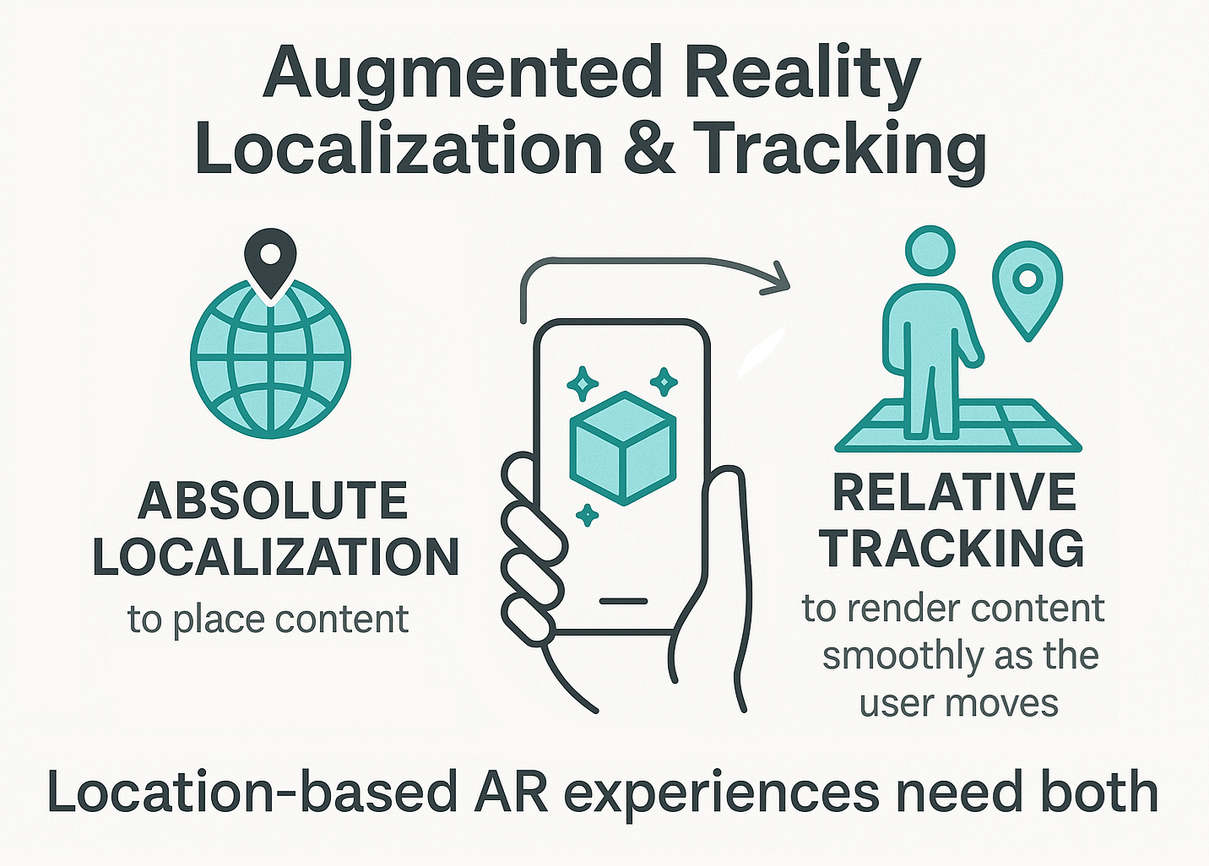
Importance of Localization in AR
Aligns digital content with the real world
Notes:
Key concepts: image-based localization, spatial anchors, persistent AR

Slide 16
What is Visual Positioning? (VPS)
Visual positioning:
Identifies where in physical space a device is located
Monitors device movement to align it in space
Maintain relative positioning for digital content
Visual Positioning requires:
A previously scanned / mapped area
Client devices with a camera, additional sensors improve accuracy
Methods to localize a device relative to a mapped space
Light

Slide 17
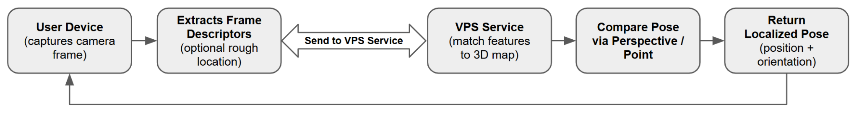
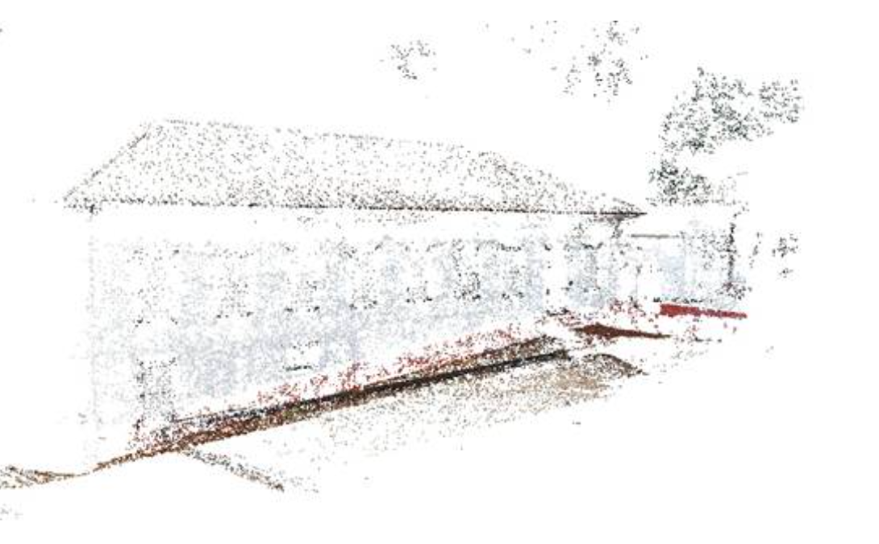
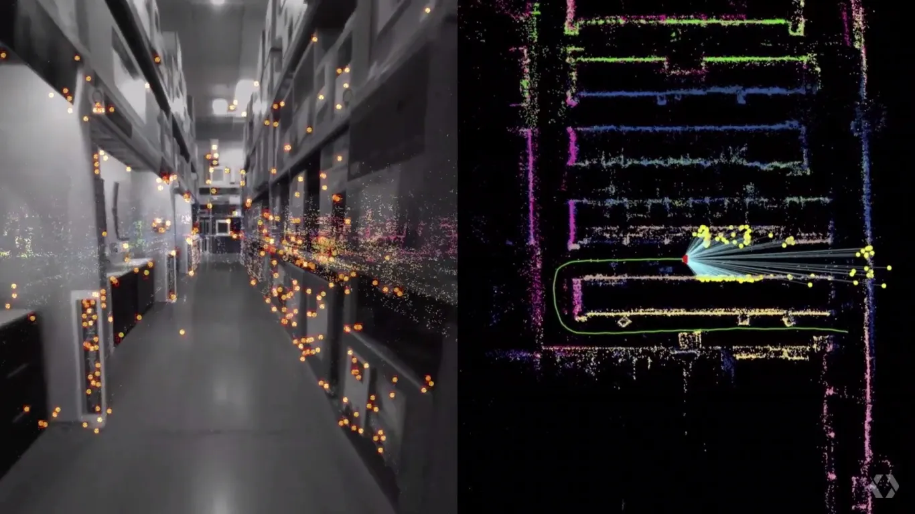
Visual Positioning Systems (VPS)
Map the location >>> Localize device using map >>> Discover content anchored at location

Slide 18
Possible localization methods
Technology | Strengths | Limitations
Visual Positioning System (VPS) | High precision works well in mapped environments enables persistent AR | Requires pre-mapping, less effective in low-visibility less effective in dynamic scenes
Global Positioning System (GPS) | Wide coverage good for outdoor navigation easy to implement | Low precision (1-10m), doesn't work well indoors doesn’t work for fine AR alignment
Marker-based AR | Simple setup no need for global mapping provides user cues there is content | Limited to known markers requires visible target target must remain unobstructed
Notes:
Key concepts: image-based localization, spatial anchors, persistent AR

Slide 19
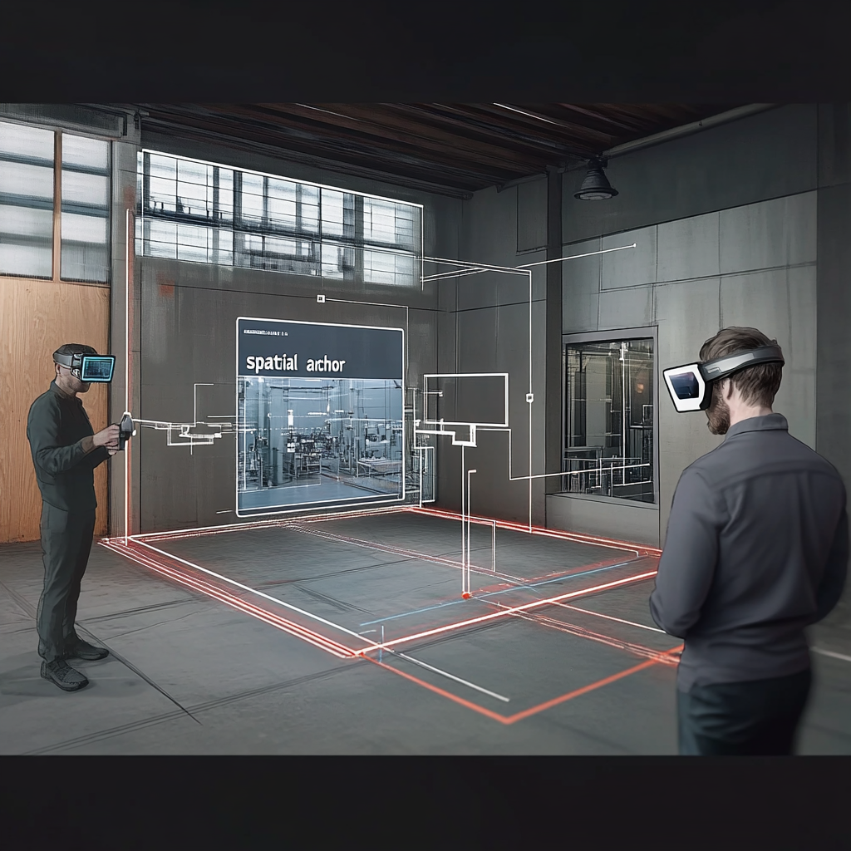



Spatial Anchors
Digital reference points that are associated with specific real-world locations
Fix digital content to precise physical points
Persistence
Shared experiences
Geospatial alignment (GeoPose)
Notes:
GeoPose is a way to describe a spatial anchor using global geographic coordinates and orientation.
Without GeoPose, spatial anchors are usually platform-specific and confined to local coordinate systems.
With GeoPose, anchors can be made interoperable and understood across platforms and apps that support the standard.
Example: place an AR label on a fire hydrant in New York:
A spatial anchor holds that label in place relative to the hydrant.
A GeoPose describes exactly where that anchor is on Earth, so another system (like a GIS platform or a second AR app) can find and use it too.
Spatial Anchors can also be considered breadcrumbs, using multiple points to anchor a space, rather than an individual feature.

Slide 20
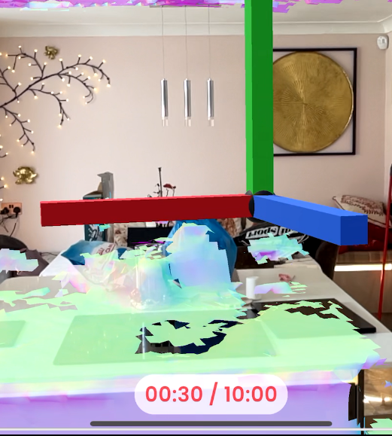
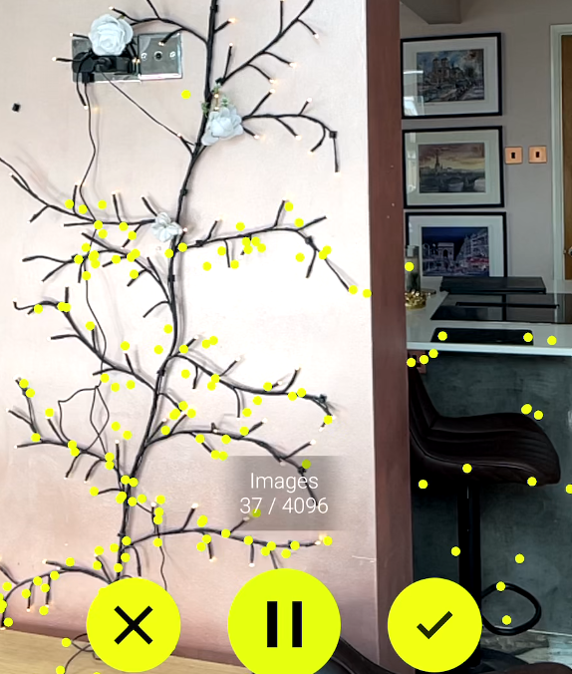
Market Assessment
Availability of VPS solutions from recognised vendors
Gaussian Splatting with MultiSet scanning
VPS solutions are diminishing
Vendors migrating to consultancies
Large leaders dominating a small space
Photogrammetry scanning with Immersal
Notes:
Guided trend away from off the shelf solutions Rise in vendor only or vendor consultancy organisations
Limited offerings for consumer solutions with tight focuses
Roadmaps are unclear for a lot of offerings, demand longevity from your chosen solution. Even Google does not offer a roadmap or guarantee of service beyond a TLA.

Slide 21
Key metrics for evaluation
Measures by which to compare VPS solutions
Accuracy (localization error, drift)
Reliability (initiation success, re-localization time)
Resilience (environmental impacts, structural change)
Scalability (coverage, number of users)
Device Support (devices, operating systems and environments)
Notes:
Measures based on real-world interview based requirements, validating factors critical for operation.
Does it meet the need
Is it repeatable with minimal effort
Does daily operation affect usage
Can the area that needs to be supported affect solution selection
What devices are needed to be supported, maintenance costs.

Slide 22
Six services studied
Down selected from 30+
Google ARCore Cloud Anchors and GeoSpatial Service
Niantic Lightship WPS and Device Mapping
Hexagon Immersal Spatial Maps
OniRix Studio
MultiSet AI
PTC Vuforia Area Targets
Notes:
Measures based on real-world interview based requirements, validating factors critical for operation.
Does it meet the need
Is it repeatable with minimal effort
Does daily operation affect usage
Can the area that needs to be supported affect solution selection
What devices are needed to be supported, maintenance costs.

Slide 23
Considerations for enterprise AR use cases
Overall performance across solutions (aggregated)
Support for indoor and outdoor
Lighting, occlusion, map availability
Content strategy
Complexity considerations (in house or consultancy)
Maintenance concerns

Slide 24
Future of VPS
Towards an AR Cloud
Newer devices: AR glasses and wearables
Market fragmentation (new entrants) and consolidation (acquisitions)
Standards and interoperability
Integration with 5G network-based positioning, robotics, IoT systems
Privacy and ethical considerations when used outside enterprise
Notes:
Overall results are mixed with no one solution providing end to end coverage.
Especially with varied conditions, multiple solutions are needed for real-world deployment
Any solution needs to cover all environmental effects, likely needing multiple scans per area at different times of day. Warning, map to environment matching can degrade.
How you intend to manage content should be a KEY consideration in vendor selection, as some solutions require you to embed content directly in the maps, updates would require redeployment.
No solution is standalone and will need maintenance and planning/reporting processes.
VPS only the foundation of any solution, what is the business value add on top of the solution, what is it for.
For complex requirements, consultancy led may be the best option to reduce costs.

Slide 25

THANK YOU
Q & A
Simon Jackson and Tony Hodgson
Ethar, Inc. 832.317.3703
sjackson@ethar.com thodgson@ethar.com

Slide 26
Metaverse Standards Forum Ride-Hailing Prototype 0:40

Slide 27
MSF – Real/Virtual Integration Working Group Ride Hailing Use Case Prototype
Car and Driver rendezvous with Rider
Navigation partly by visual positioning
Ground truth position, pose, and video data collected for 12 scripted “performances” of rendezvous at the UK Ordnance Survey headquarters in Southampton UK.
MSF Forum Labs project to develop a benchmarking framework to evaluate
Performance
Quality
Architectures
Sample Rendezvous from April 2023

Slide 28
Visual Positioning Prototypes Gabor Soros/Nokia Bell Labs – Point Cloud Matching Steve Smyth – Radiance Field Matching 0:45

Slide 29
OpenVPS – Gabor Soros
Presentation 19th June 2025 MSF Real/Virtual Integration Working Group
Gabor Soros/Nokia Bell Labs OpenVPS
Questions/Discussion

Slide 30
Radiance Field Modelling VPS Prototype
Project started January 2025 and ending December 2025
Similar architecture to OpenVPS but using a radiance field model as the mechanism to model the space and support matching newly presented images.
The Time Coordinate, Uncertainty, and MSF Prototype Support components are all used in the radiance field modelling prototype.
There is a hood argument that some of the imaging-specific components are not within the natural scope of GeoPose, but is is striking how many components appear explicitly here and implicitly in OpenVPS. This re-use of the concepts upon which GeoPose is built, first motivated by a request from the OGC Moving Features SWG, is the motivation for componentizing GeoPose.
Radiance Field Modelling Service Prototype
Questions/Discussion
1:15

Slide 31
MSF Forum Labs VPS Benchmark Framework Project
About Forum Labs initiative
Draft Description
Questions/Discussion
1:30

Slide 32

Forum Labs At-a-Glance
Metaverse Standards Forum Labs Initiative
A Win-Win program to achieve goals of mutual interest/highest impact
Forum Benefits
Resources and expertise for practical, tangible, pre- and post-standardization real-world testing and development
Refine and validate requirements and standards needed for Metaverse interoperability
Accelerate the application of concepts captured/developed in Forum Working Group meetings and reports
Labs Benefits
Eligible labs become Forum approved (think: Labs label)
Promotion and networking with Forum membership
Forum alignment assists in lab’s credibility when submitting grant applications
Visibility and industry insights into industry use cases and requirements – not working in a vacuum
Ability to partner with the Forum Working Groups for Forum Labs-labelled interoperability projects
Initiation
Identification and mutual assessment of lab for Forum certification by one or more Working Groups
Qualification
Confirmation that labs meets Eligibility criteria. Certification agreement executed
Promotion
Lab may promote its Certification
Execution
Projects execute and results published
Follows a model well proven in other consortia (e.g., Open Geospatial Consortium Testbeds and Projects)

Slide 33
Project Discovery, Design, and Delivery Pipeline
Lab must acknowledge receipt of project requests from WGs and respond with details about how a new request fits or is not in scope for the lab
If in scope and resources are available or provided, the lab should provide a plan for supporting the WG, such as implementing projects to clarify open topics and/or validate requirements
After one year the lab is requested to submit results of its development of KPIs for Metaverse interoperability and performance
(Voting) WG Members
Ensure that requirements, standards and other approaches to interoperability are realistic and scalable
Project Description
Complete a Lab project template that captures the purpose, design and expected outcomes of the proposed project
Deliverables
As described in the approved project description
FINAL APPROVAL
Task: WG members to approve project’s deliverables
Public Deliverables
Reports and/or software
For more details, see next slide
Iterate until agreement
Non-public deliverables

Slide 34
Forum Lab Project Description (See Template)
Purpose and Process
Expected Deliverables and Impacts
Purpose
Testing in real world conditions
Prototyping
Validation
Performance measurement
Required skills
Complete a table with skills and names of people who have these
Required technologies
Complete tables with sections such as Hardware | Software | Services
Step-by-step process (methodology)
Validation procedures
Timeline
List of standards tested
Interoperability requirements not met by current standards
Running code
Report
Video
[more?]

Slide 35
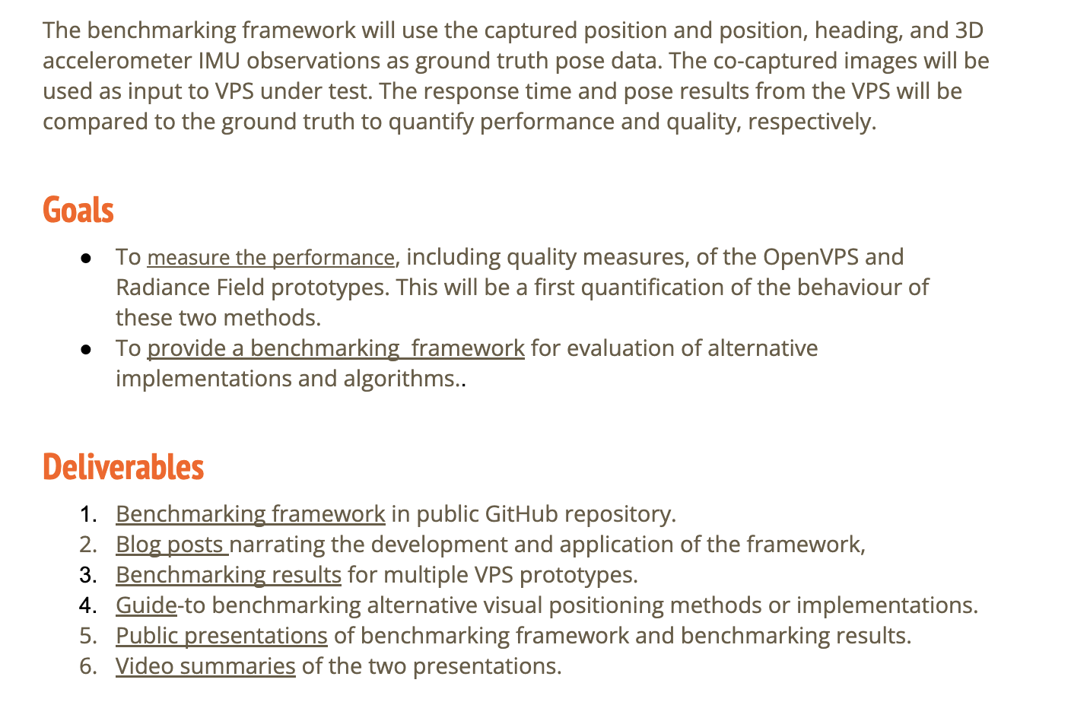
Draft description of our first project
https://docs.google.com/document/d/1y5M1tKEwsKxqSleCXFb6oznURtz7WtDDrwD8RmE4H3U/edit?tab=t.0#heading=h.z6ne0og04bp5

Slide 36
WP 5: Time Coordinate Rob Smith 1:40

Slide 37
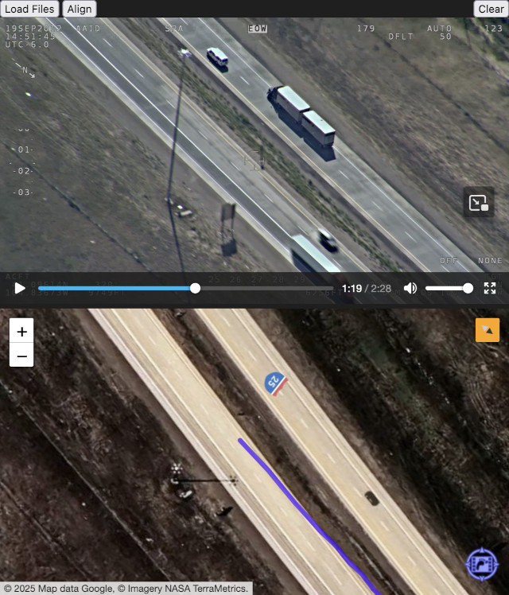
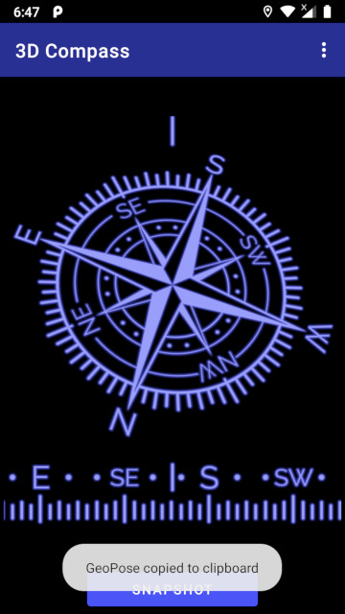
WP5: Time Coordinate – Design
OGC Testbed-20 Aerial Observation
Calculated GeoPose from MISB video metadata
Frame centre & sensor location tags
Synchronised with video using WebVMT
Matched map rotation with camera heading
Simplified image cognition in web browser
Video: https://webvmt.org/demos/testbed#testbed-20
3D Compass
Record device GeoPose snapshot
Free Android app: https://www.awayteam.co.uk/products/3dcompass/about
Testbed-20 Aerial Observation
3D Compass App

Slide 38
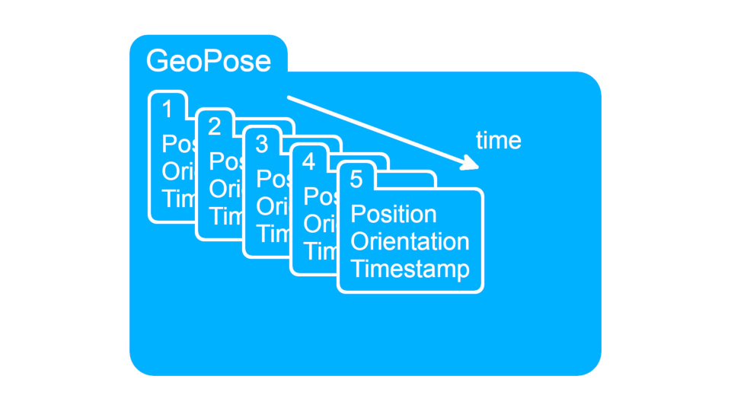
WP5: Time Coordinate – Use Cases
Monotonically increasing number
No discontinuities or ambiguities in timeline
Avoids leap seconds
Avoids notation complexity
Hour-minute-second & day-month-year
Calculate numerical durations & differences
Number of ticks
Date-time epoch
Associate GeoPose timeline with real time
Relative to Unix time, UTC, TAI, MJD & other temporal references
Timed GeoPose Sequence

Slide 39
WP-7: Uncertainty GeoPose 1.x 1:55

Slide 40
Uncertainty - Jim Antonisse/Steve Smyth
Value uncertainty
If it is a number, then you can define precision, accuracy, granularity
If it is a category, then you can define confidence
Objective uncertainty
Positional uncertainty ellipsoid
What is the equivalent for orientation
Angles seem clear
Quaternions not so much
Headed toward multiple components with different application scenarios and harmonization with other standards and practices.

Slide 41
Image Elements GeoPose 1.x 2:05

Slide 42
Image Elements – Steve Smyth
Think back to Gabor’s presentation
Trying to define reusable components that are already in the OSCP GeoPose Protocol.
Or define components that can be composed to support that functionality.
Ver use-case-specific.

Slide 43
Discussion Time, Uncertainty, and Visual Positioning Support. 2:15

Slide 44
Review Components by WP
(We have 25 proposed components in four groups. Review by looking a group diagram, then each component in sequence. Discussion embedded in process. About 1 minute of explanation per component.)
A component is a datatype or a class
Justified by a use case
Must be conceptually in scope
Needs a machine-readable schema – I am trying to make JSON-Schema do the job but I would not yet say that I am winning the battle to avoid starting with UML.
The values of a datatype or properties of a class need required ability to represent whatever it is that they communicate. So JSON Numbers are useless as a specification. I am experimenting with the JSON-Schema “format” property but the AI workers in my toolchain do not yet respect my wishes.
I hope that we have some discussion as we go through the list, from which I can collect your suggestions, corrections, or other contributions and publish as a revised set of slides.

Slide 45
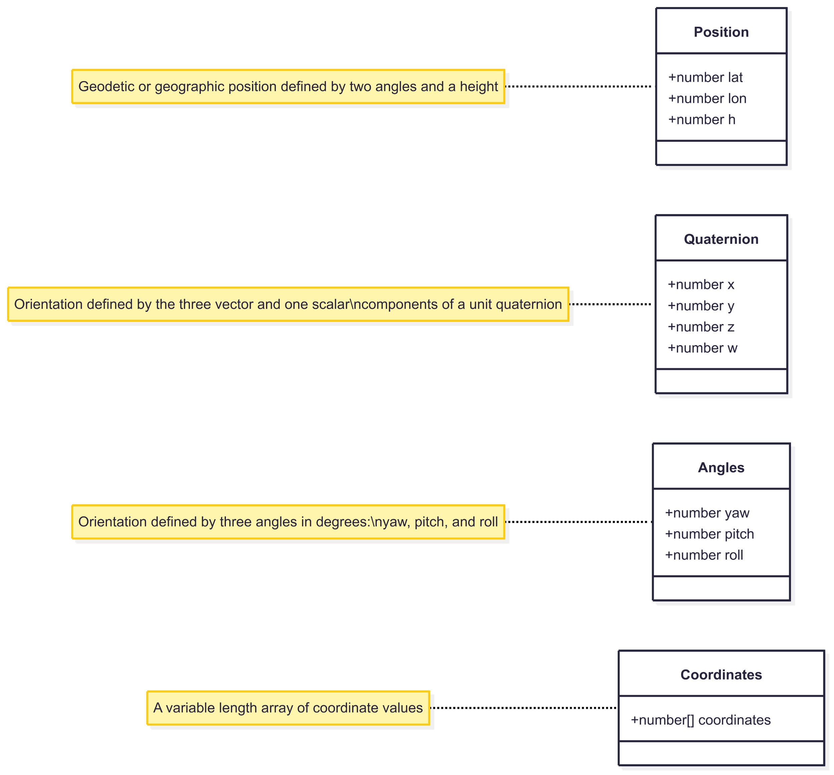
Core Components
2:20

Slide 46
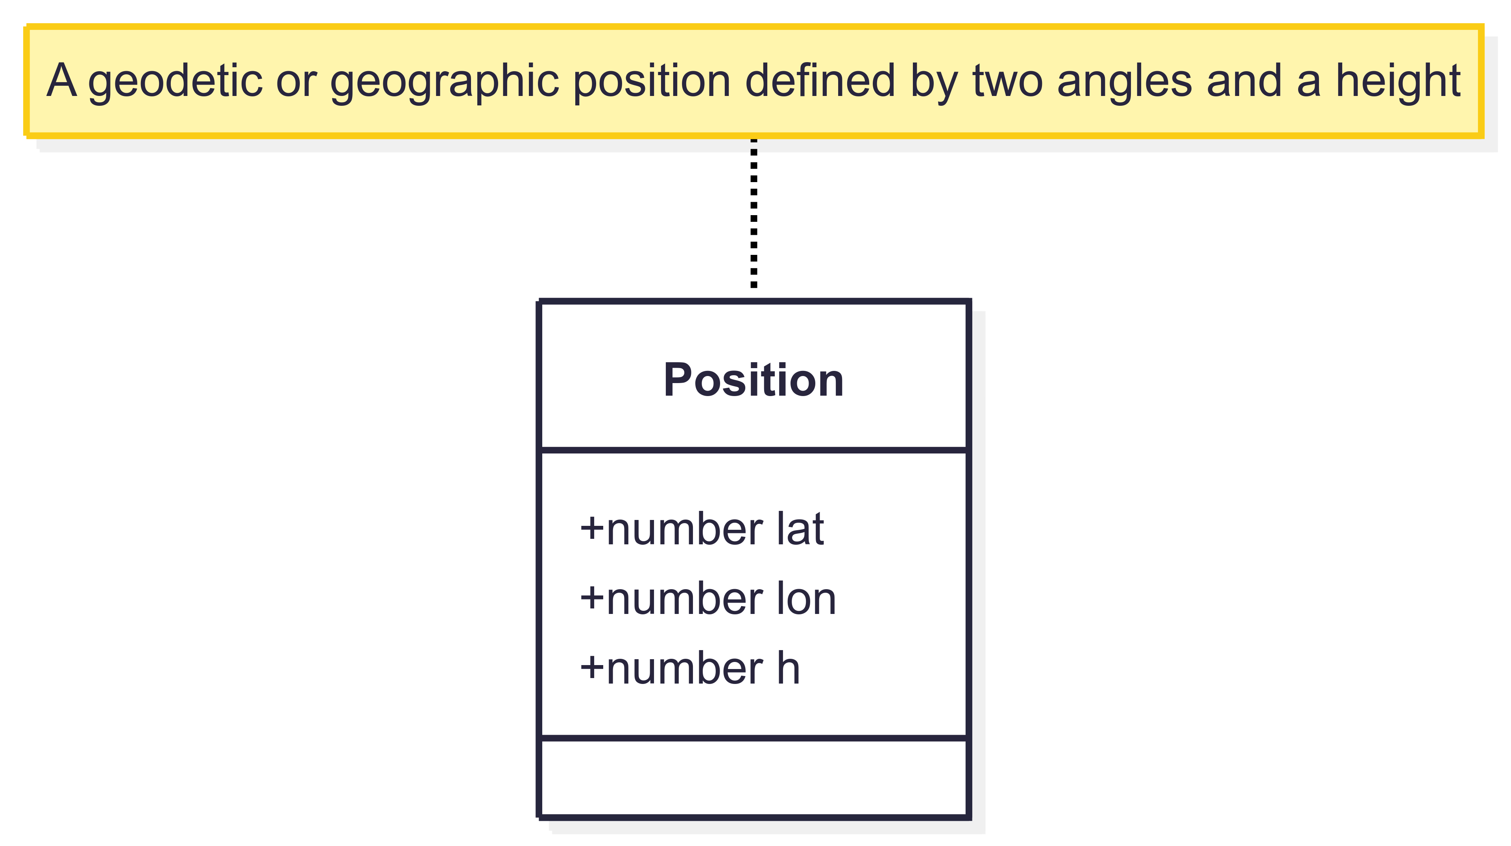
Core Components – Position

Slide 47
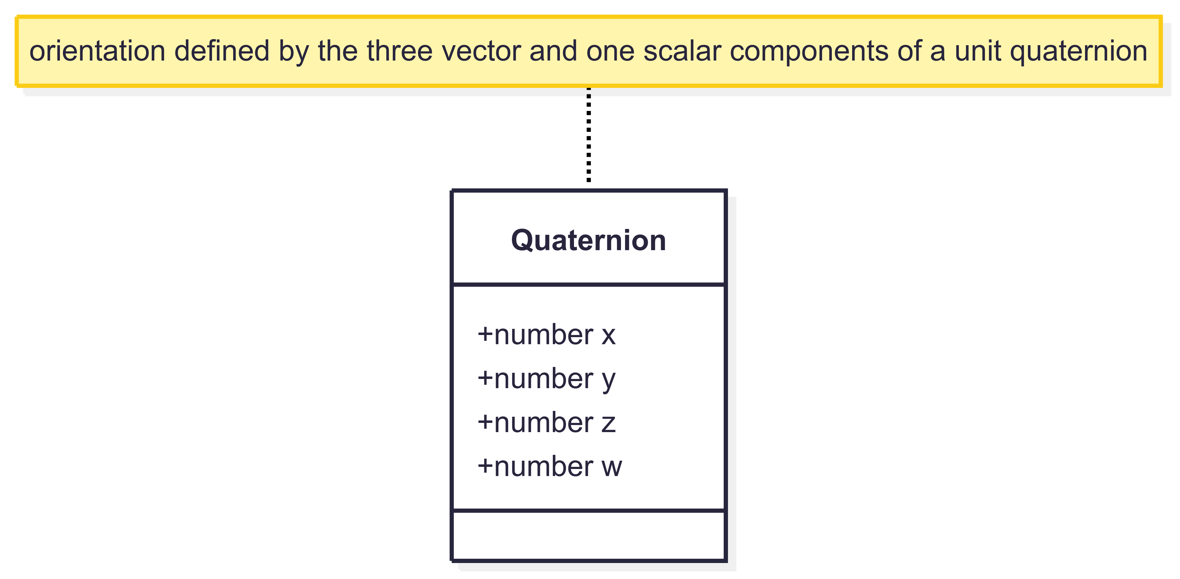
Core Components – Quaternion

Slide 48
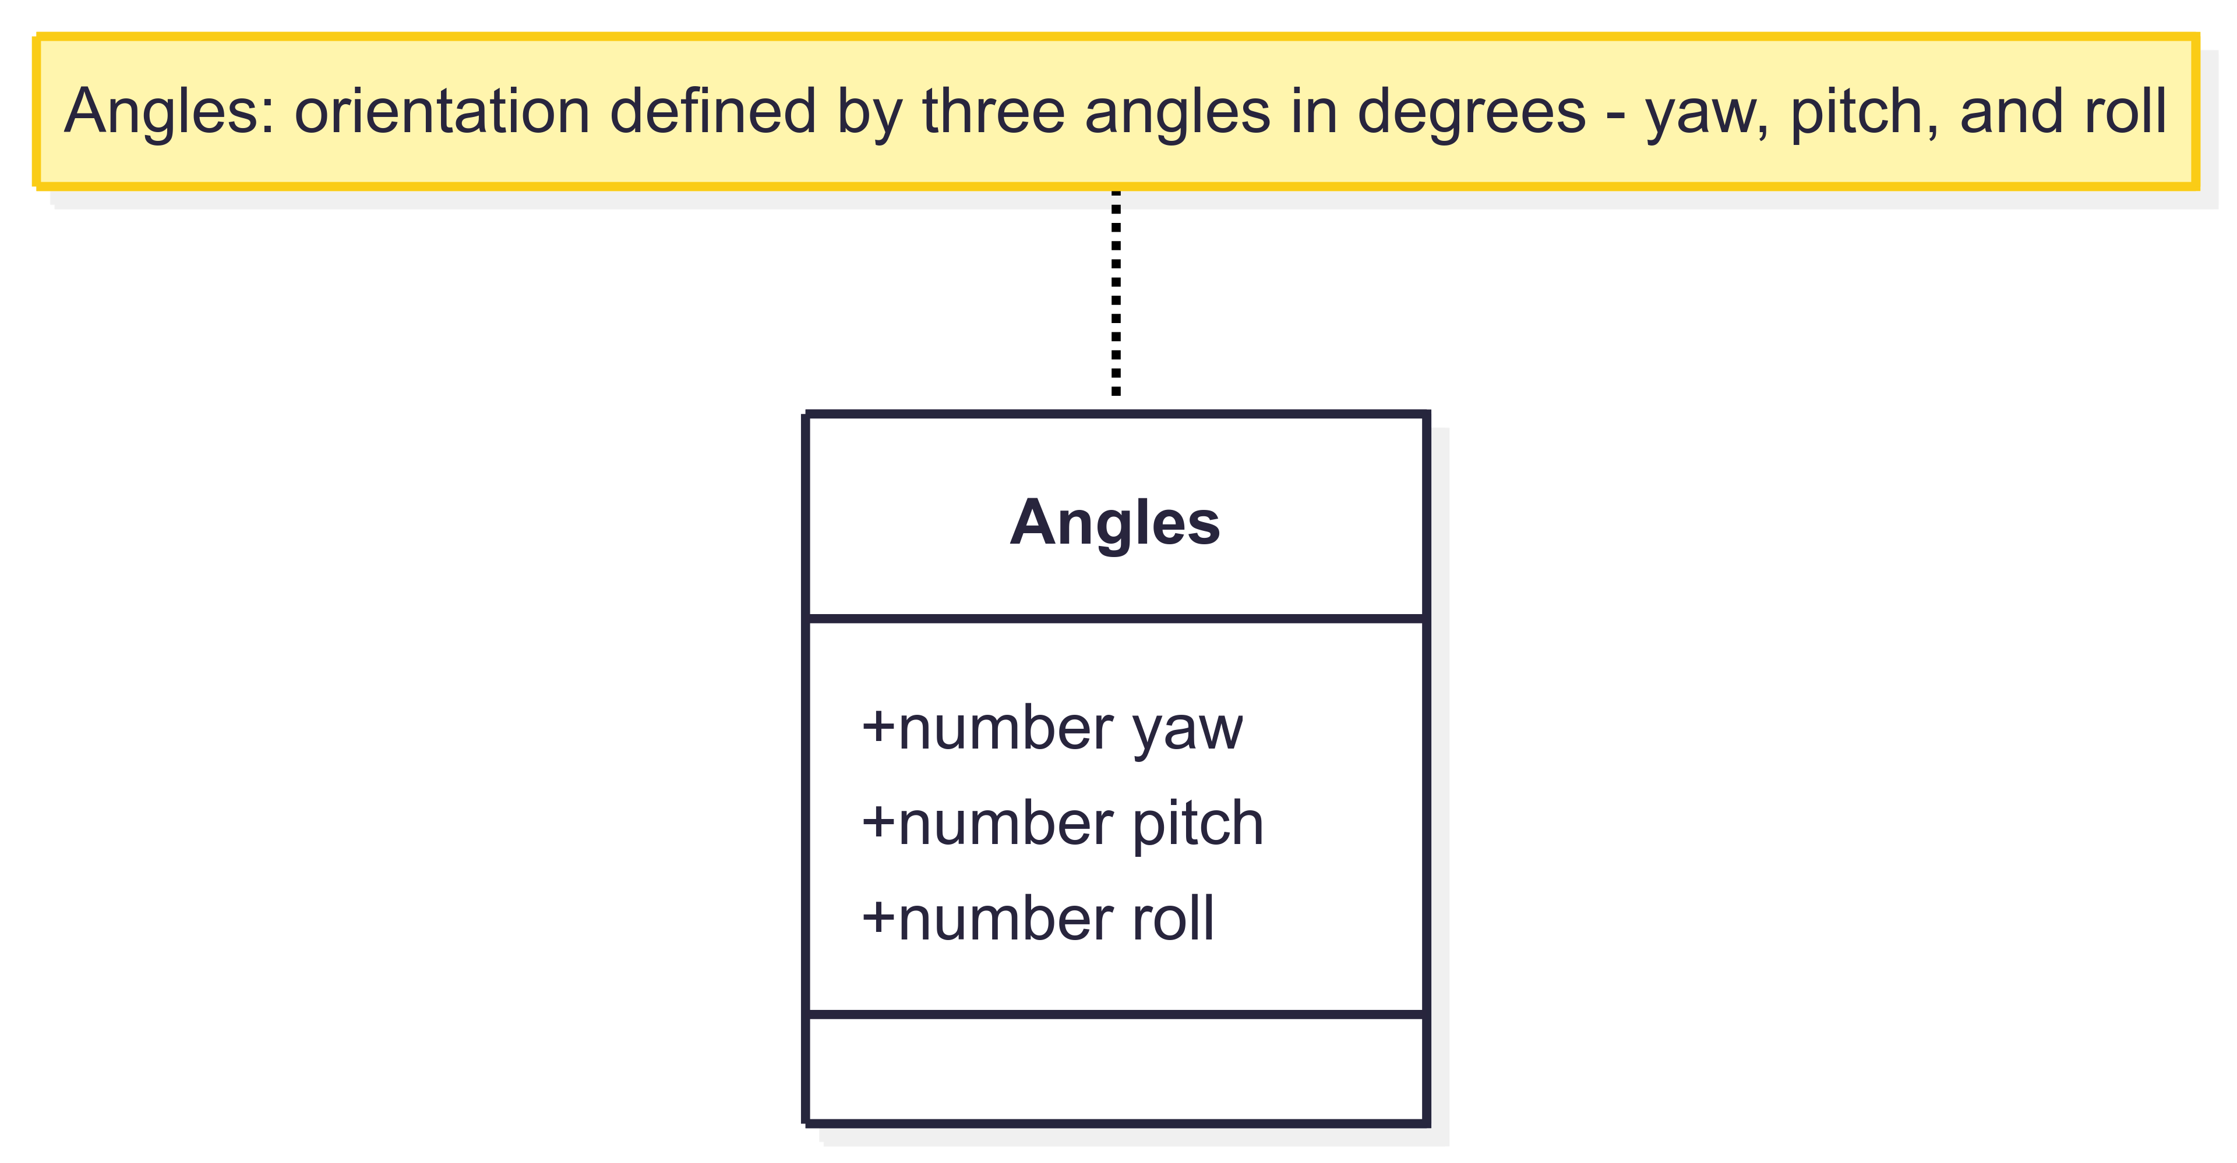
Core Components – Angles

Slide 49
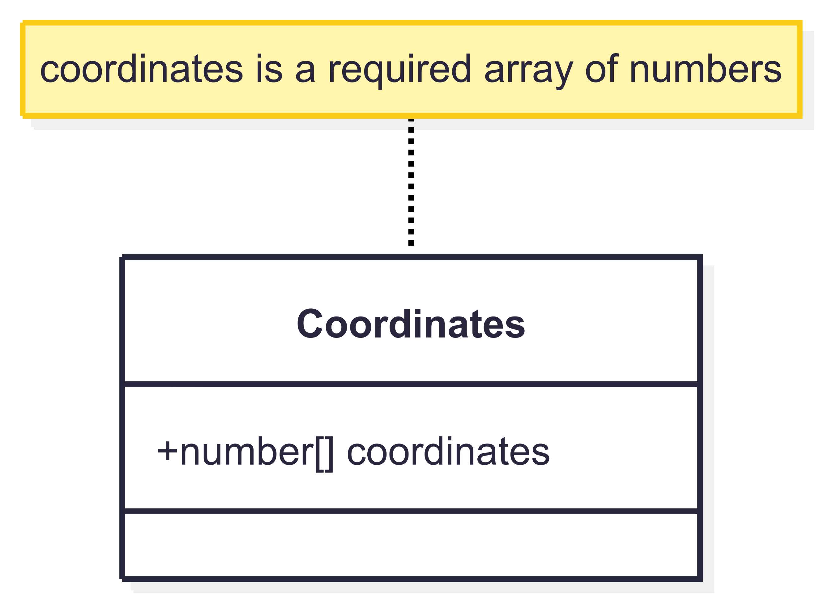
Core Components – Coordinates

Slide 50
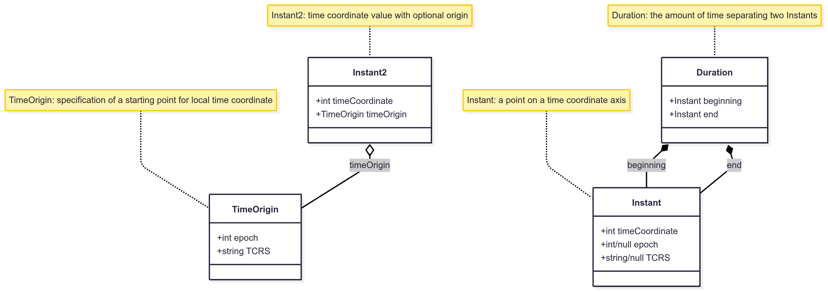




Time Coordinate Components
2:30

Slide 51
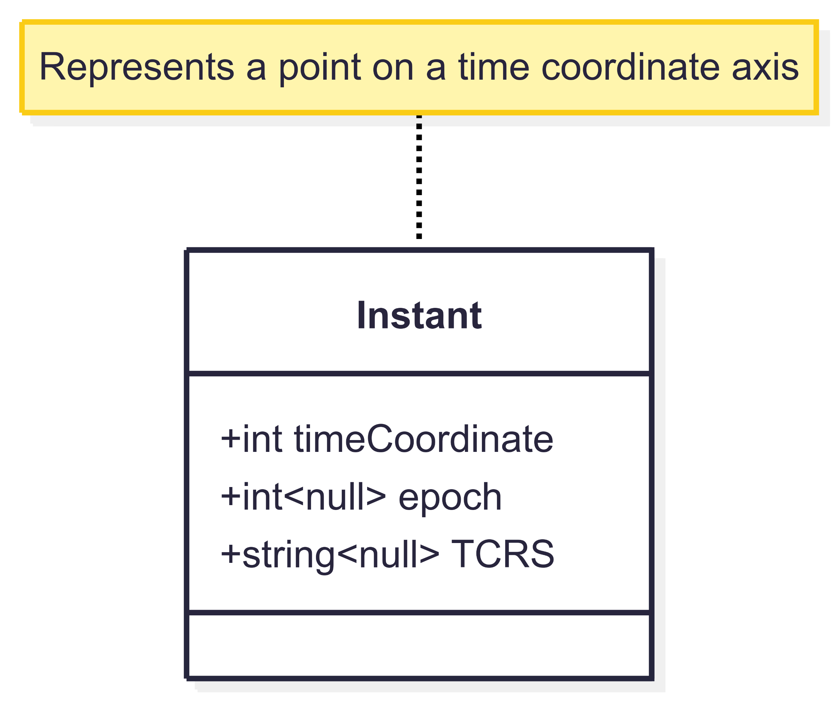
Time Coordinate - Instant

Slide 52
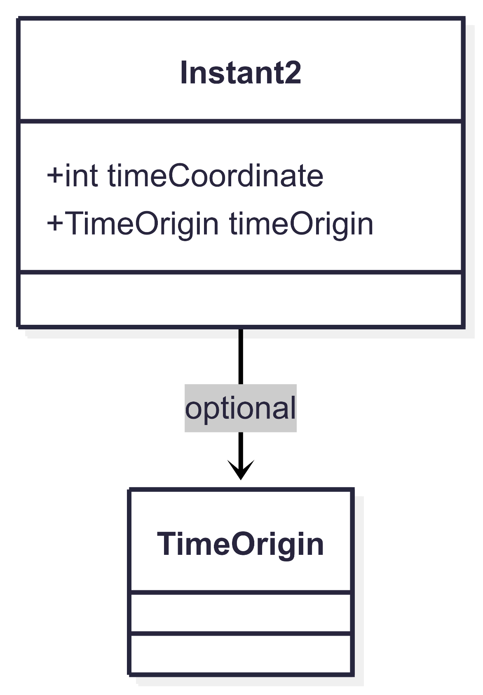
Time Coordinate – Instant2

Slide 53
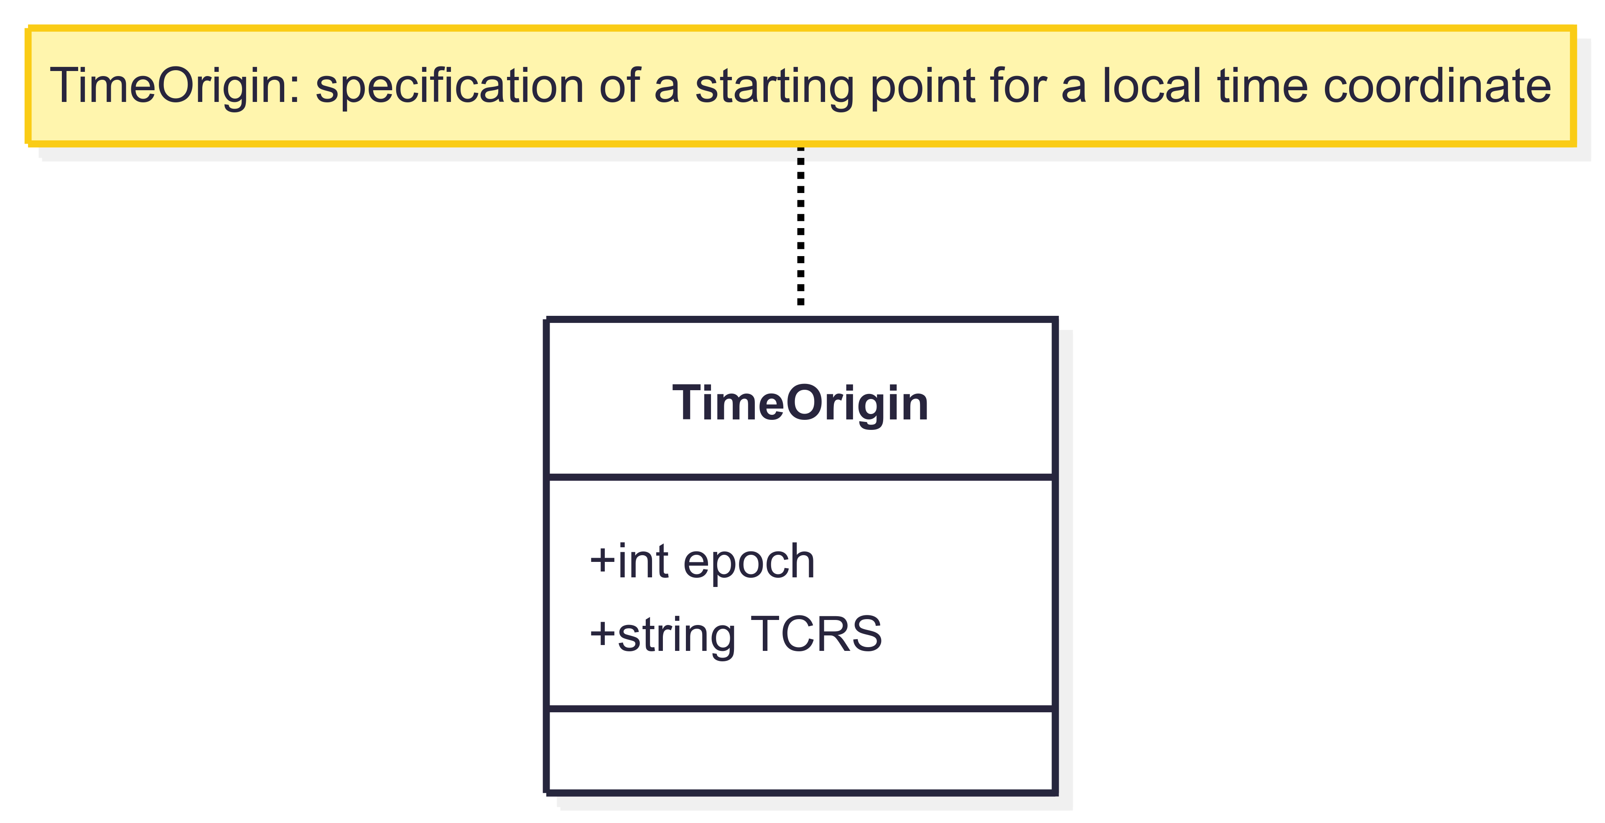
Time Coordinate – TimeOrigin

Slide 54
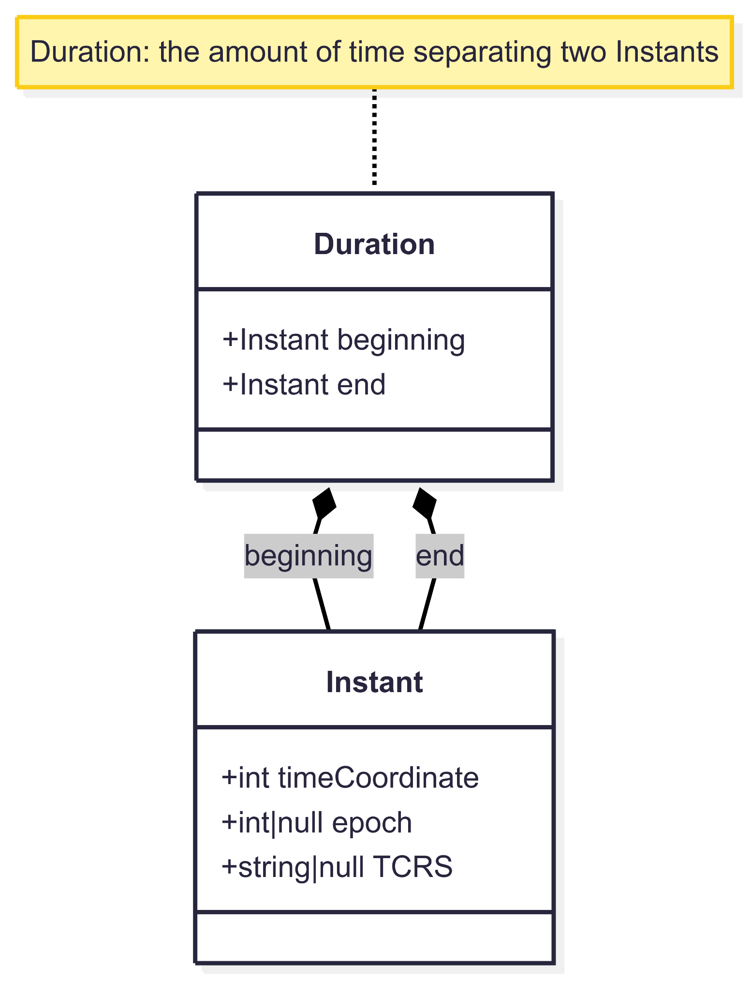
Time Coordinate - Duration

Slide 55
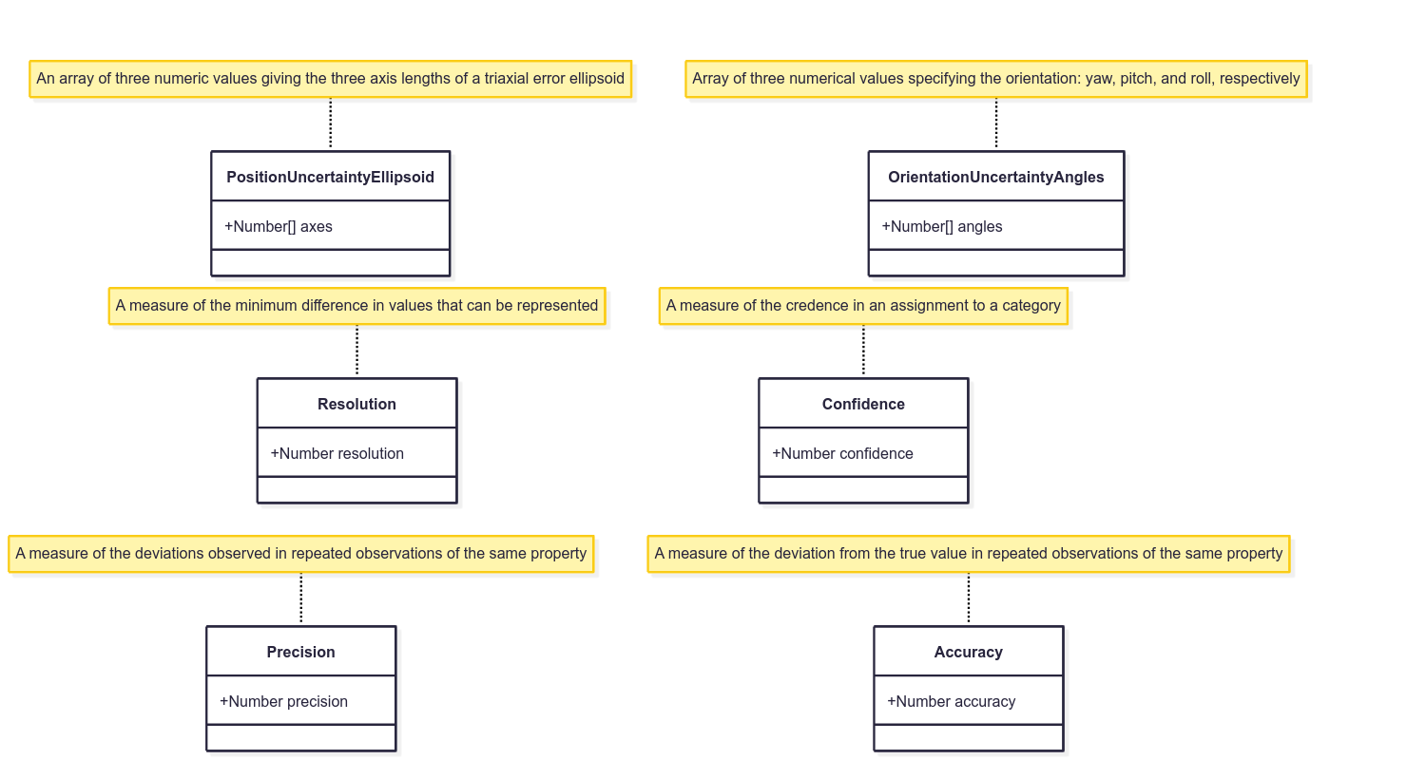
Uncertainty Components
2:40

Slide 56
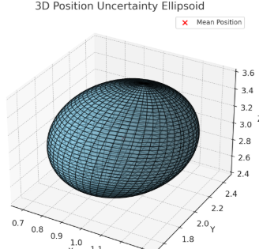
Uncertainty Components – PositionUncertaintyEllipsoid
A 3D position uncertainty ellipsoid, visualizes the spread and orientation of uncertainty around a central point in space. The red dot indicates the mean (expected) position, and the ellipsoid's shape and orientation are derived from the covariance matrix, representing positional variance in all directions.

Slide 57
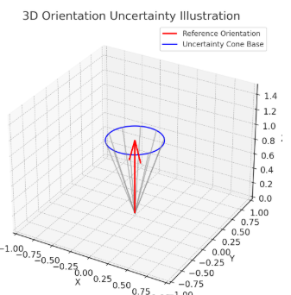
Uncertainty Components – OrientationUncertaintyAngles
Here is a 3D illustration of orientation uncertainty. The red arrow represents the reference orientation, and the blue circle and gray lines form a cone showing possible deviations within a 20-degree uncertainty range. This captures the idea that the orientation could point in any direction within the cone’s spread.

Slide 58
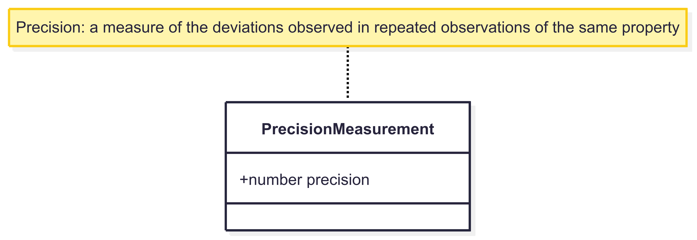
Uncertainty Components – Precision

Slide 59
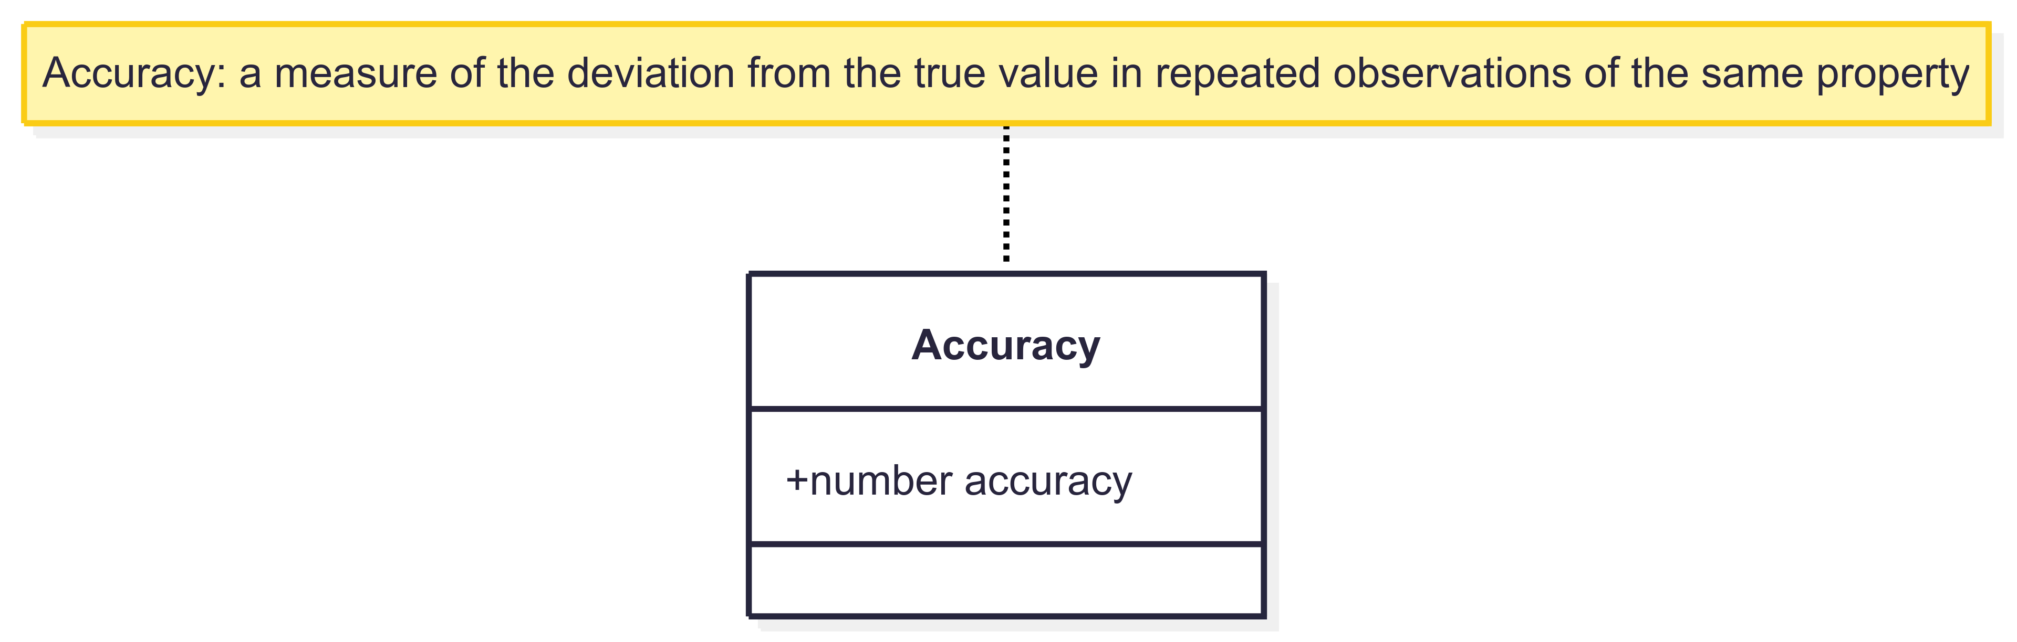
Uncertainty Components – Accuracy

Slide 60
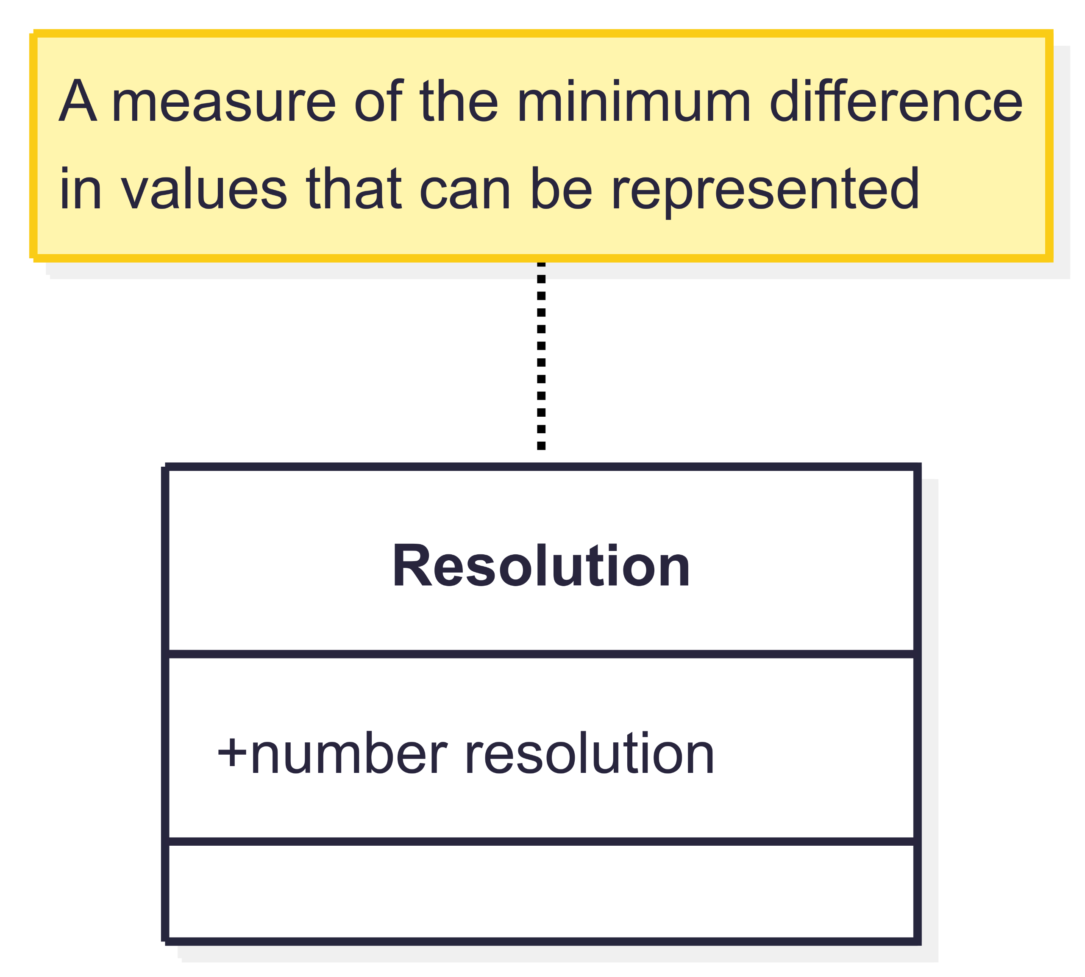
Uncertainty Components – Resolution

Slide 61
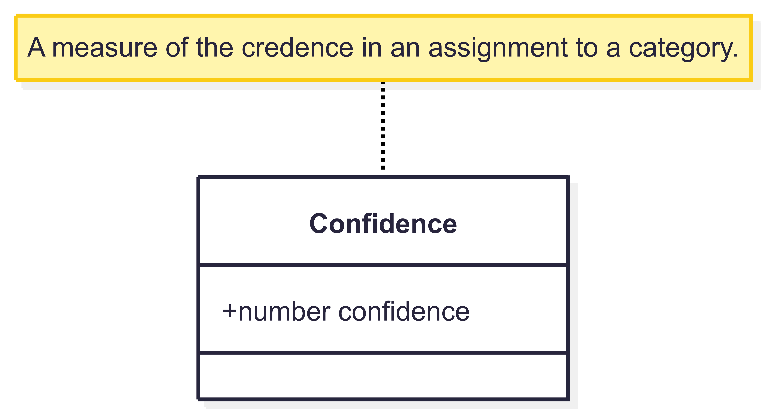
Uncertainty Components – Confidence

Slide 62
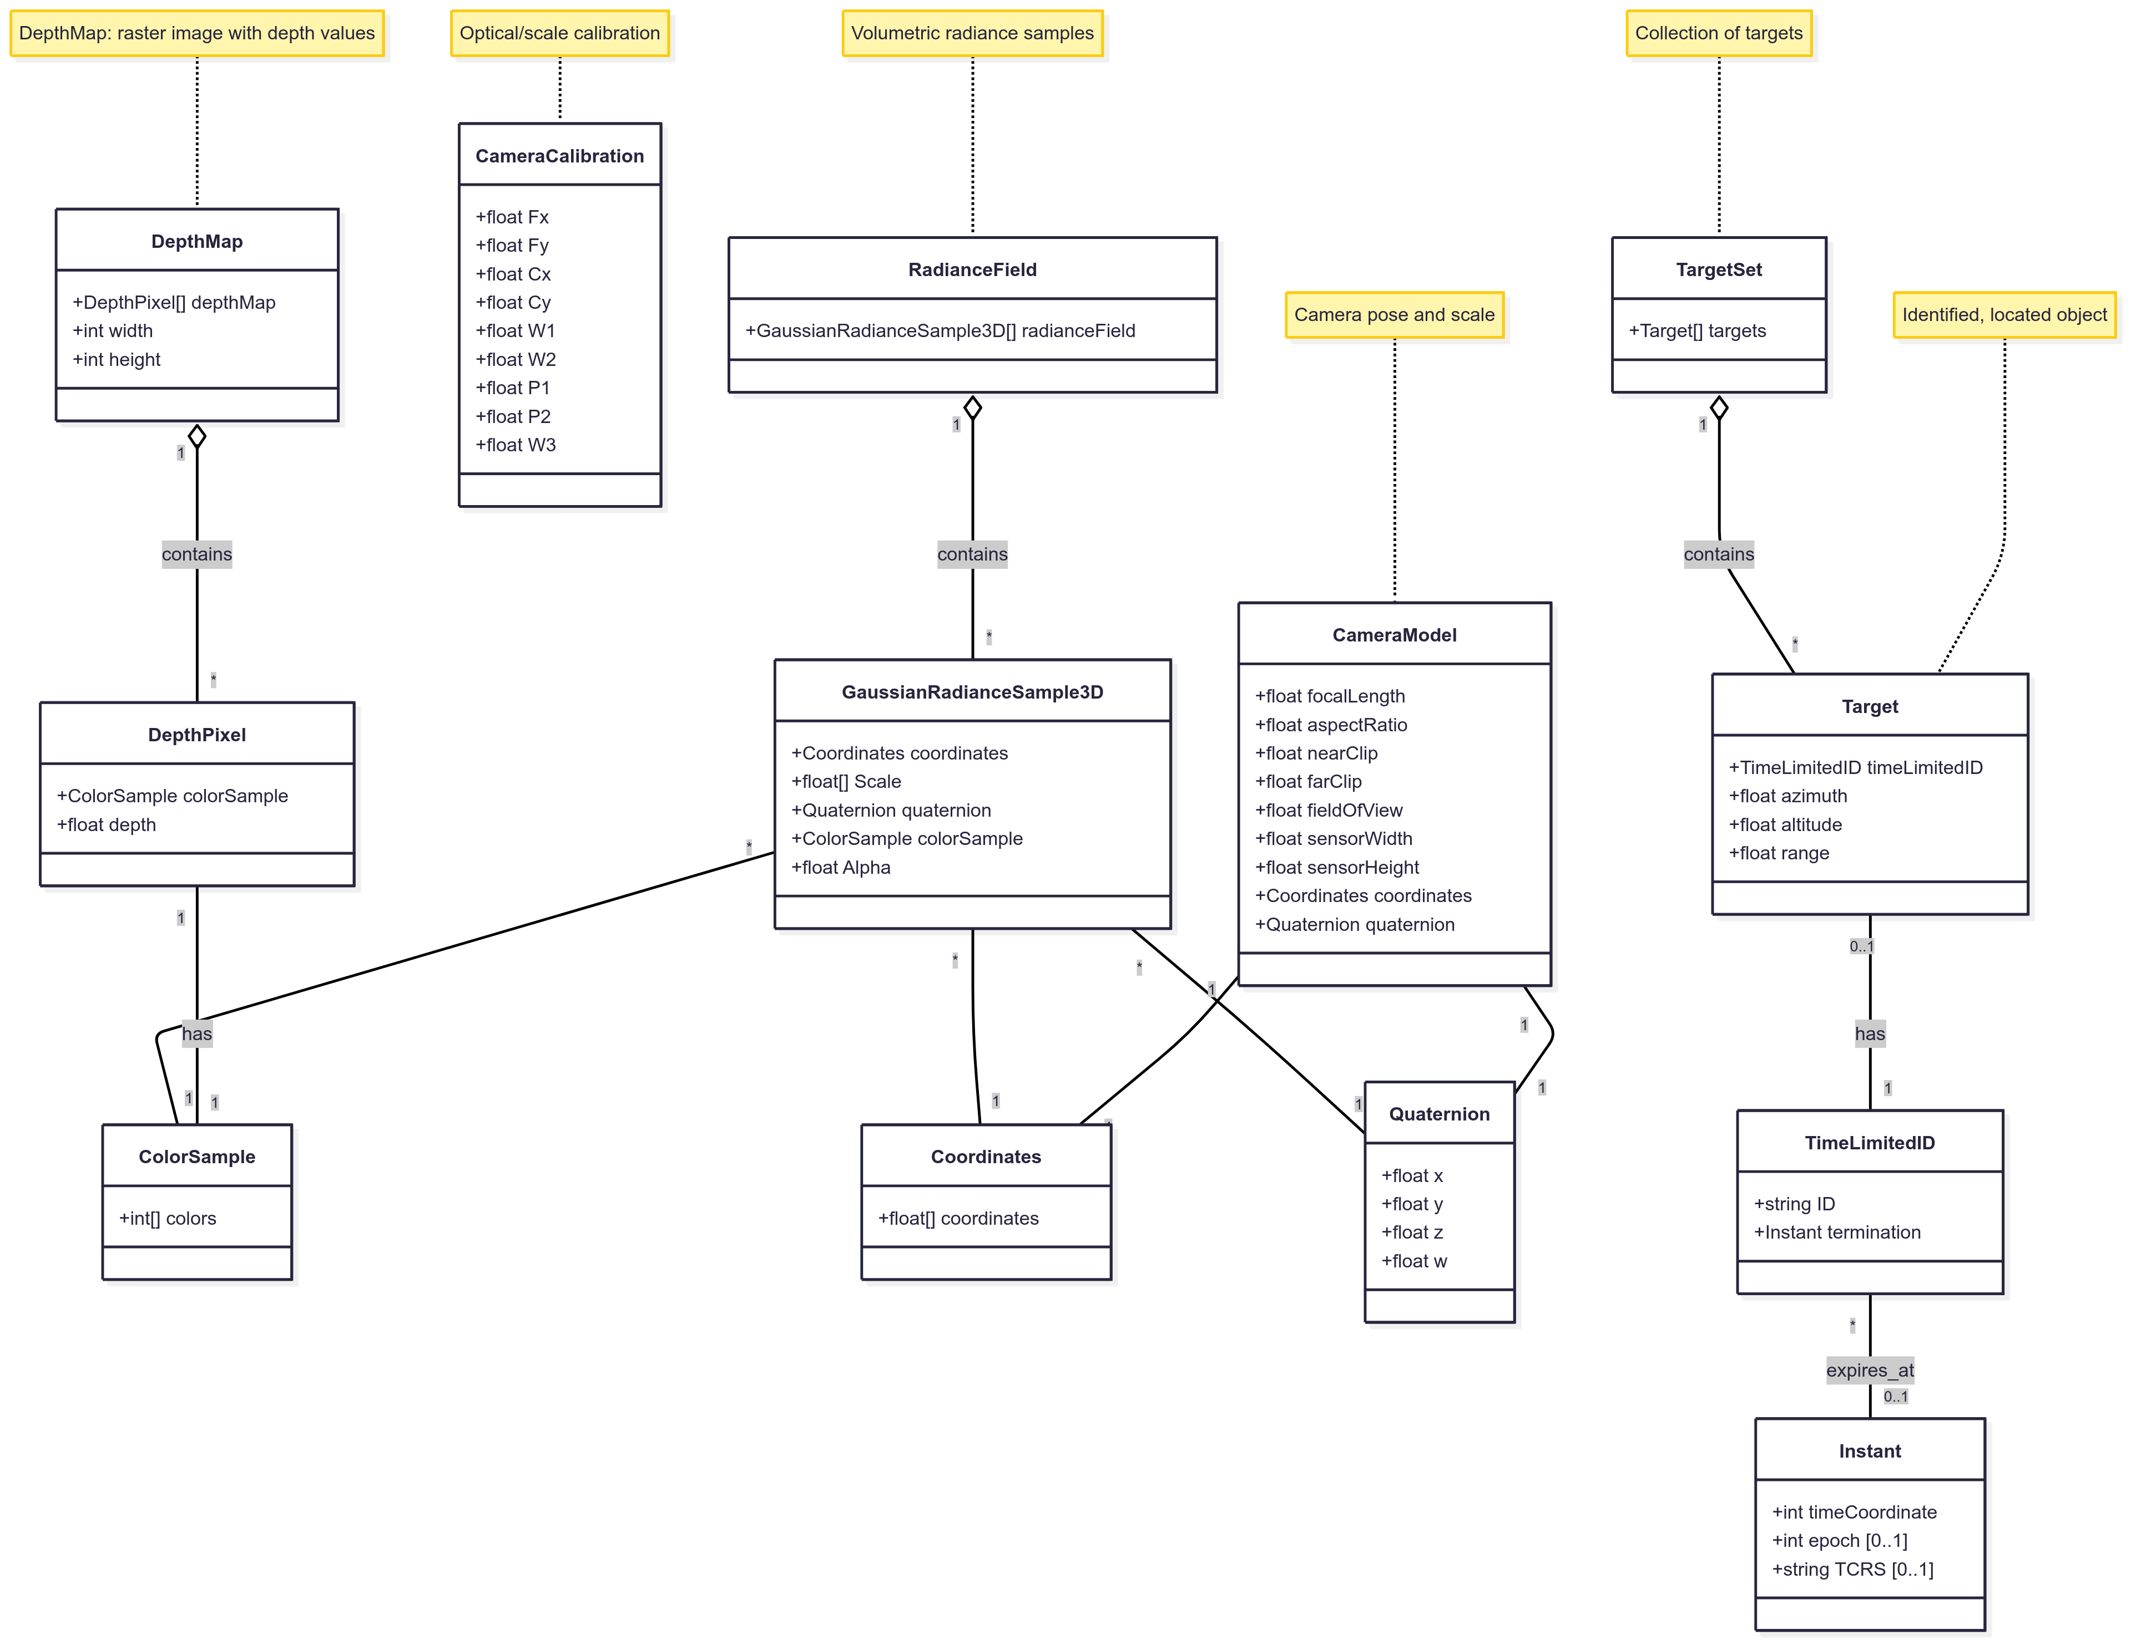
Image Element Components
2:30

Slide 63
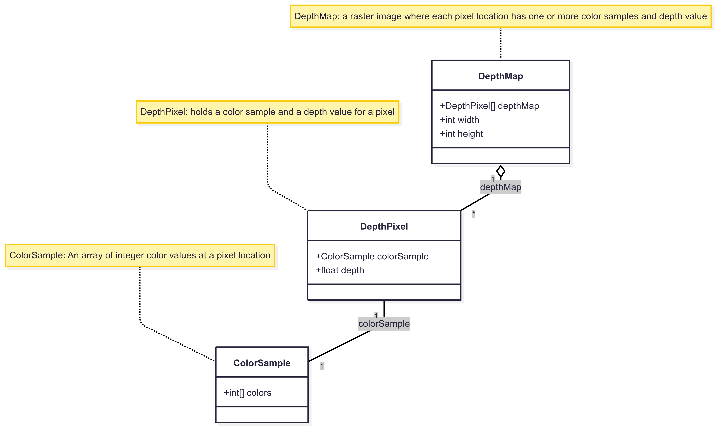
Image Element Components – DepthMap

Slide 64
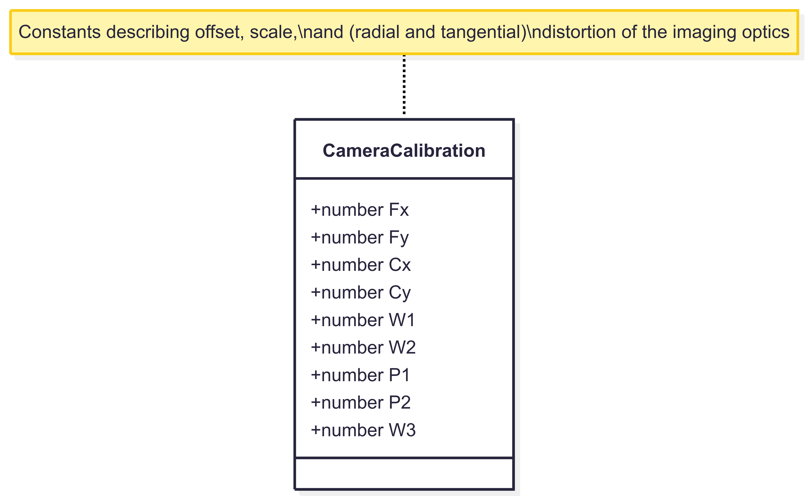
Image Element Components – CameraCalibration

Slide 65
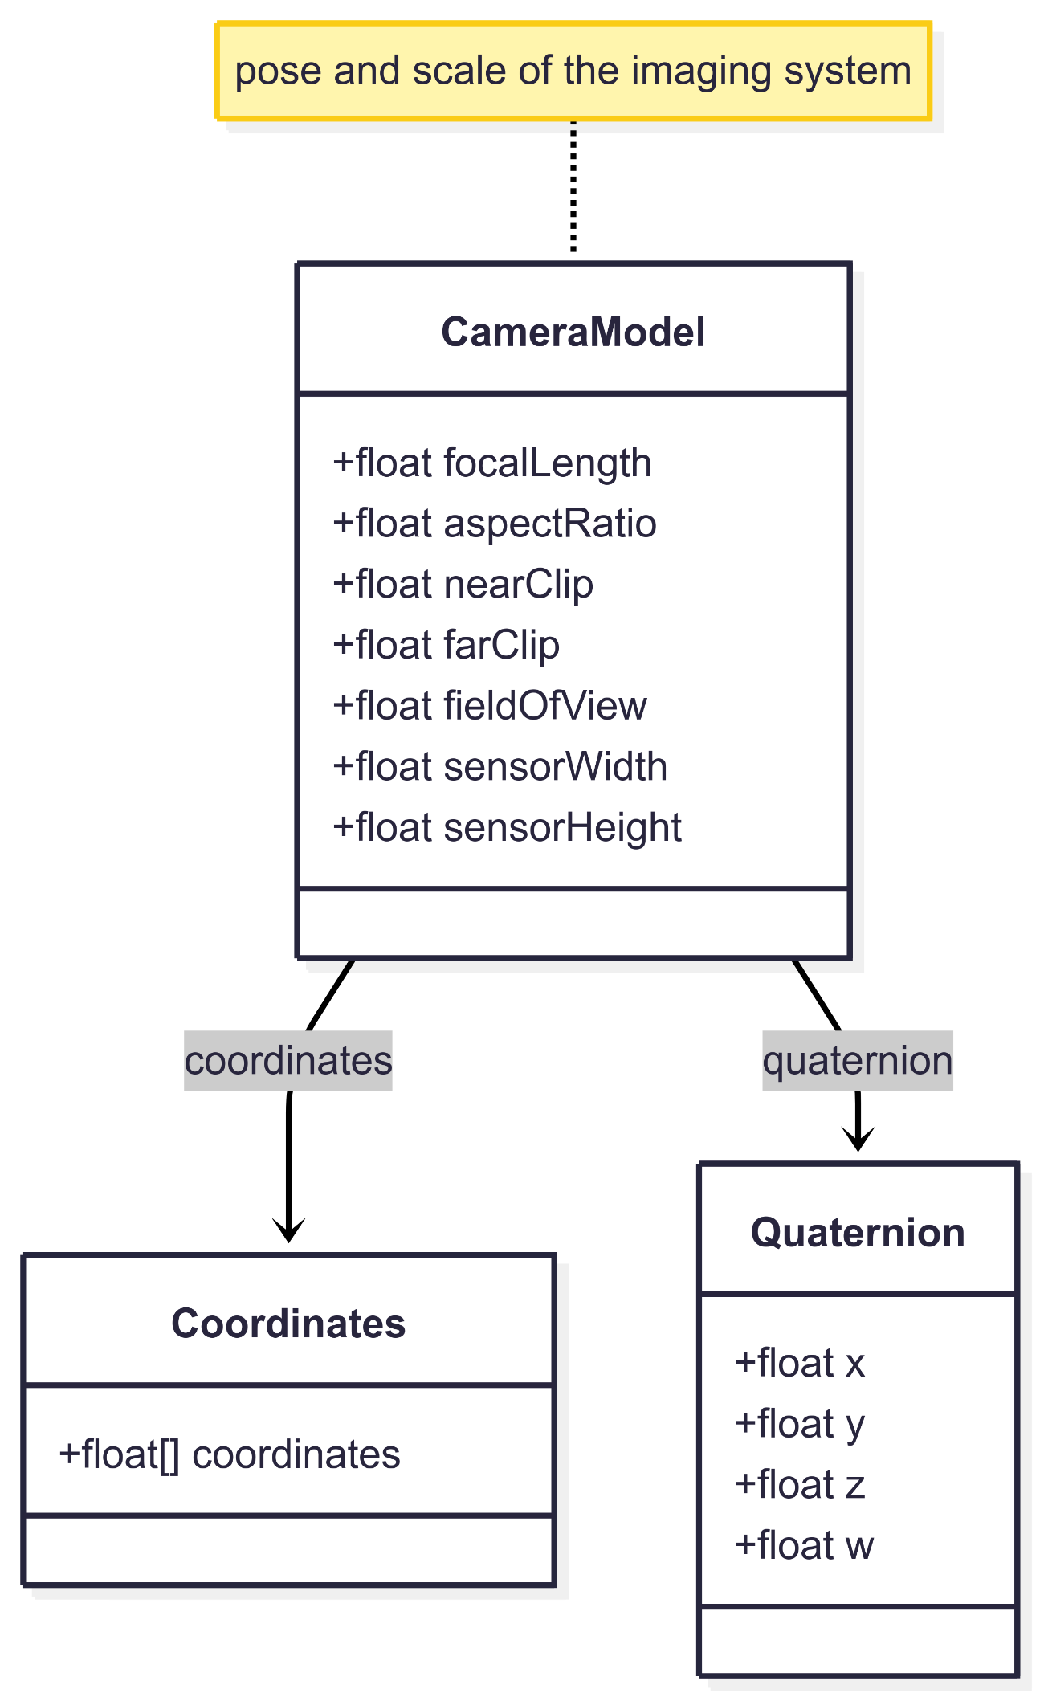
Image Element Components – CameraModel

Slide 66
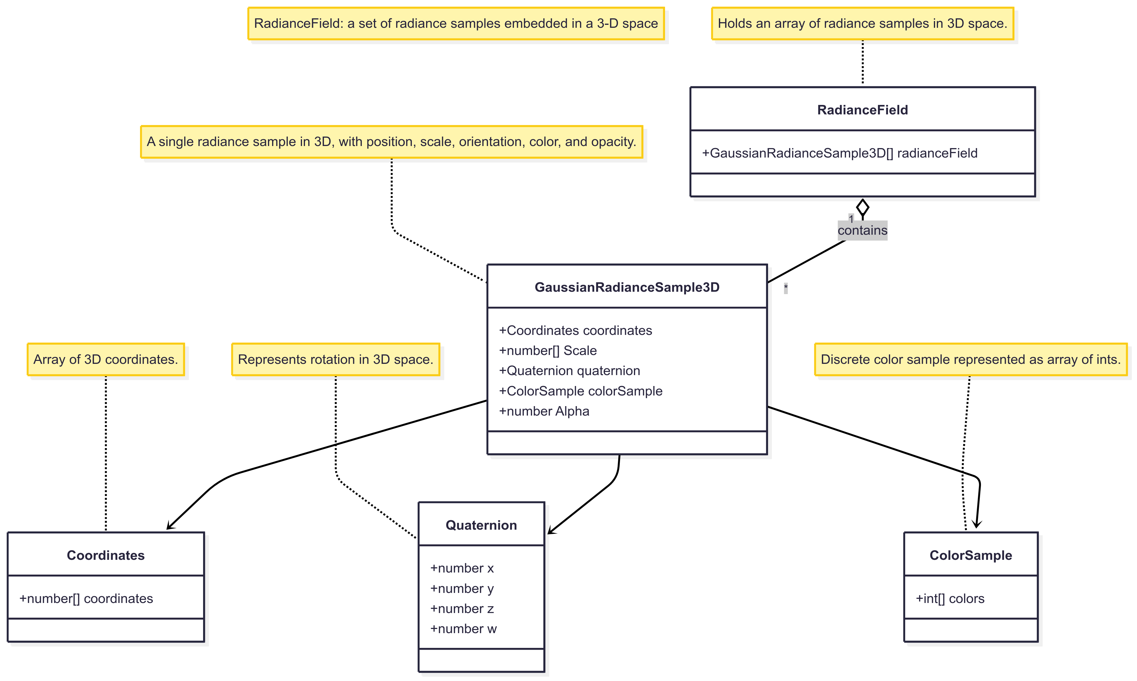
Image Element Components – RadianceField

Slide 67
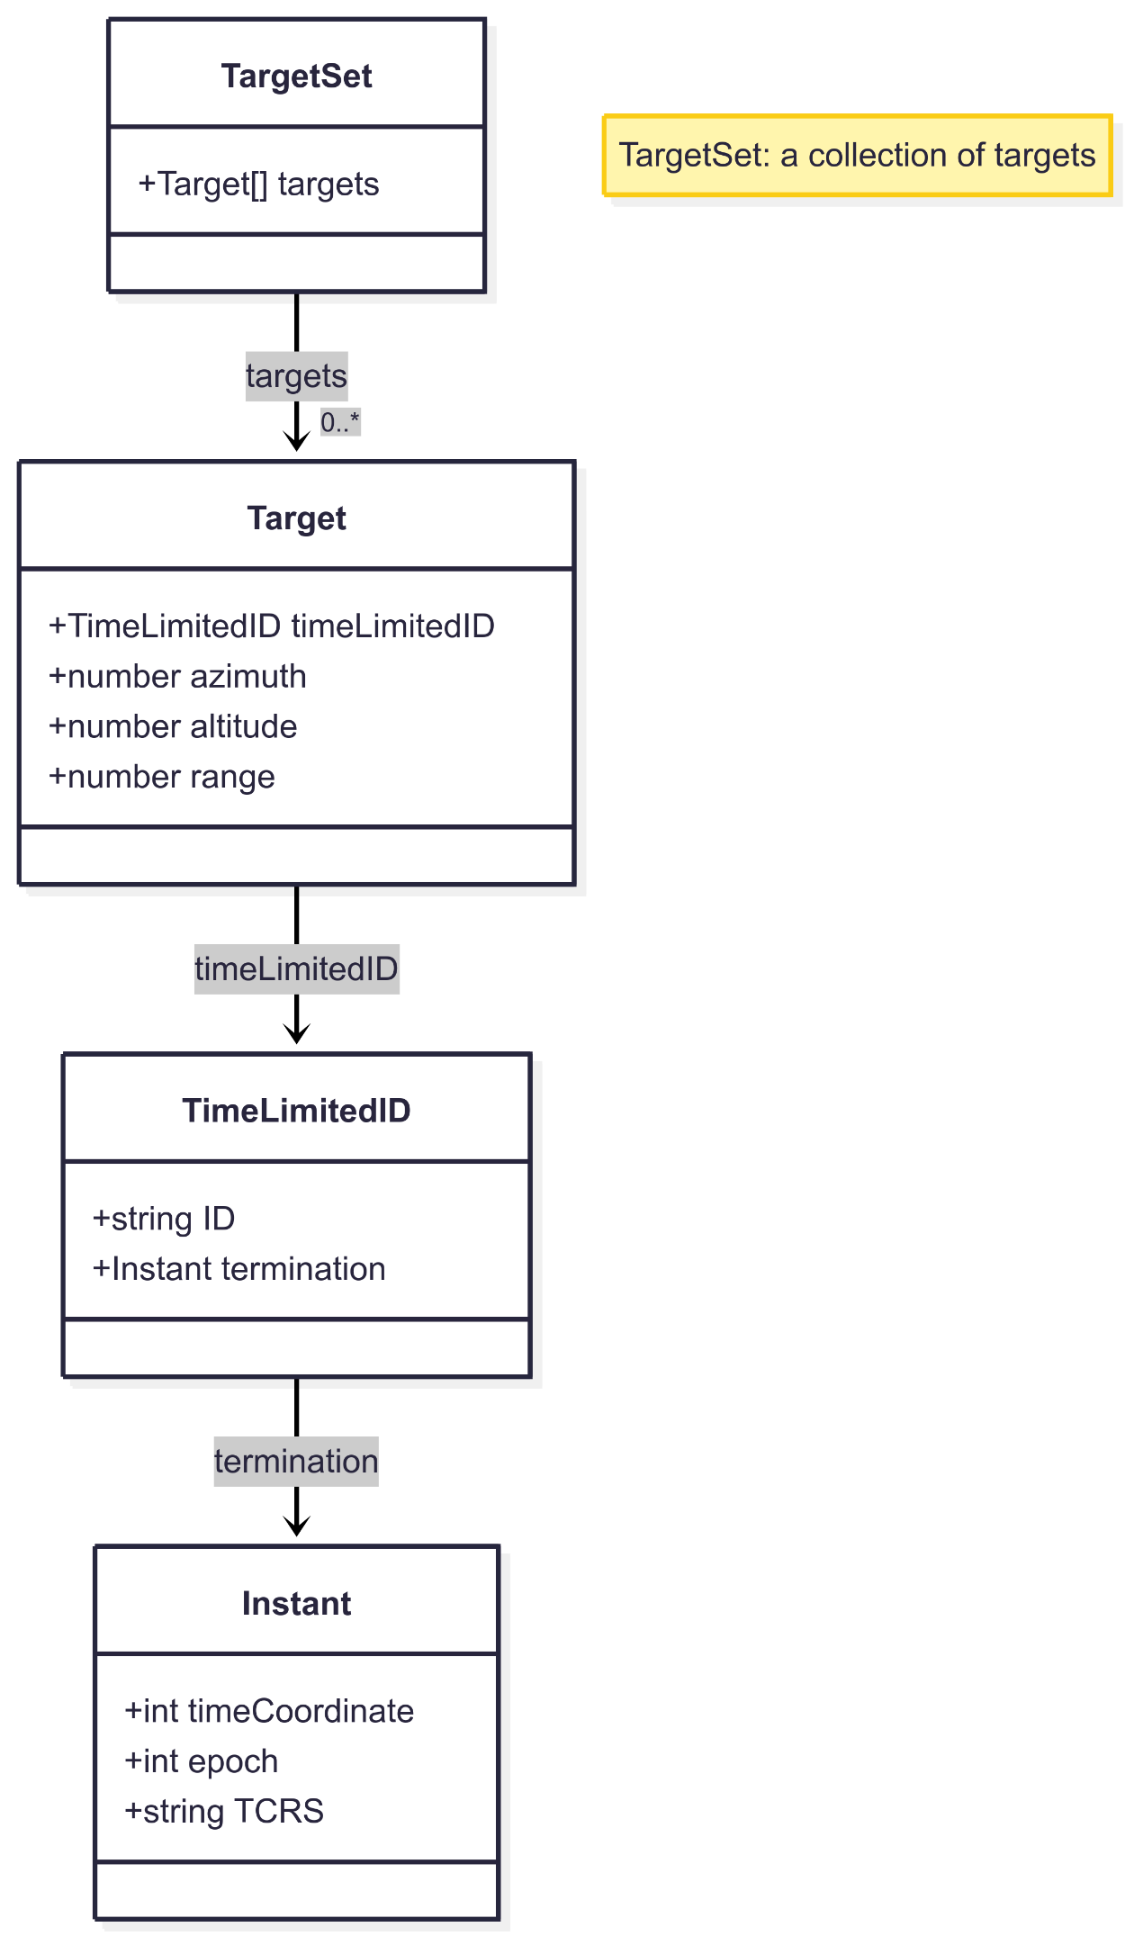
Image Element Components – TargetSet

Slide 68
Wrapup Time, Uncertainty, and Visual Positioning Support. 3:00

Slide 69


THANK YOU
www.ogc.org
metaverse-standards.org

Slide 70
Workshop
Preview of Time, Uncertainty, and Visual Positioning Support Workshop
27 June 2025
Online at 15:00 UTC
Reference material here
Background
Time Coordinate
Uncertainty
Visual Positioning Support
Discussion/Questions

